Slide 1



Instant Sanitary Napkin Vending & Dispenser
TEAM:DESIGN THINKERS
TEAM ID:TM-187

Slide 2




Our Team
SOWNDAR K
TEAM LEAD
&
SOFTWARE DEVELOPER
SHWETHAA G P
HARDWARE EXPERT
DISHA D
PROJECT INFLUENCER
HARISH S
PRODUCT DESIGNER

Slide 3

PROBLEM STATEMENT

Slide 4

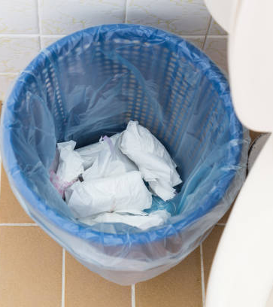

Slide 5


497 million women
in INDIA
48% female in total population (by 2018)
Places where crowd goes more
56 % Female goes for school, colleges, etc..
Shopping Malls, Hospitals, public places, schools, colleges, etc…
31 % Female goes for job
Some will work overtime
Unavailable shops at night
13% stay at home
Doing some house-hold works as home-makers & servants
‘n’ number of places where people (Feminine gender) moves around
Reference Courtesy: http://censusindia.gov.in

Slide 6


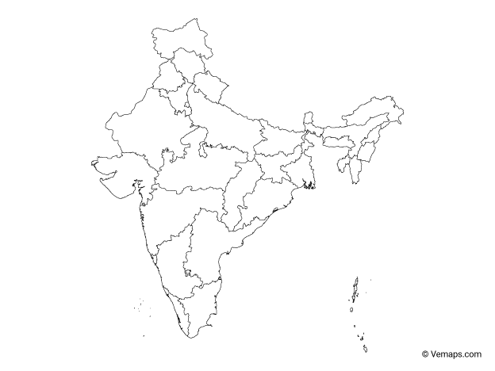
Sizable Market
TAM
Feminine gender
SAM
Women b/w the age of 10-55 Years
SOM
People Using Our Product At Times Of Menstrual Cycle & Emergency Situations
Total Addressable Market
Service Addressable Market
Service Obtainable Market

Slide 7
356
Total women/girls attended the survey
* Management Survey through direct interview

Slide 8
Survey taken from various Age groups
18-25
202
26-35
104
36-45
43
45 +
7

Slide 9
Annoyed about the disposal method followed in the workspace
18-25
Got Annoyed
202
26-35
Got Annoyed
104
36-45
Got Annoyed
43
45 +
7

Slide 10

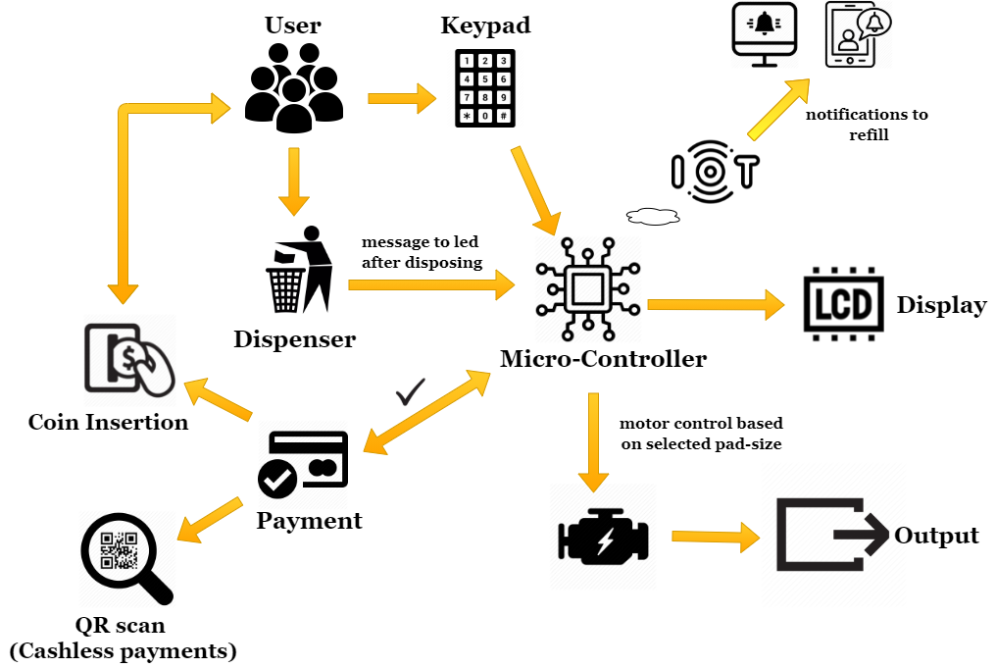
SOLUTION

Slide 11






Phases of Development
How we have made the idea into a solution for customer’s pain point…
01
02
03
04
05
Searched for a Realtime Problem & What exactly they need for that problem
Done Various Public case Studies & gathered user needs as per their pain point
Generated Different ideas and started working with a best solution from it
Developed a working model & done basic testing
Re-defined the working prototype after several customer interactions over the solution

Slide 12











Strategy to promote
Product to Venture
Direct implementation (Tie-up with manufacturers)
Implemented in public places, hospitals, theatres, malls, schools, colleges, etc…
End User - Women
(Our Happy Customers)
One single compatible product
Can be sold on rental or commission basis
Online sales
Sales through
Distributors
Distributor commission (or) referral based sale

Slide 13
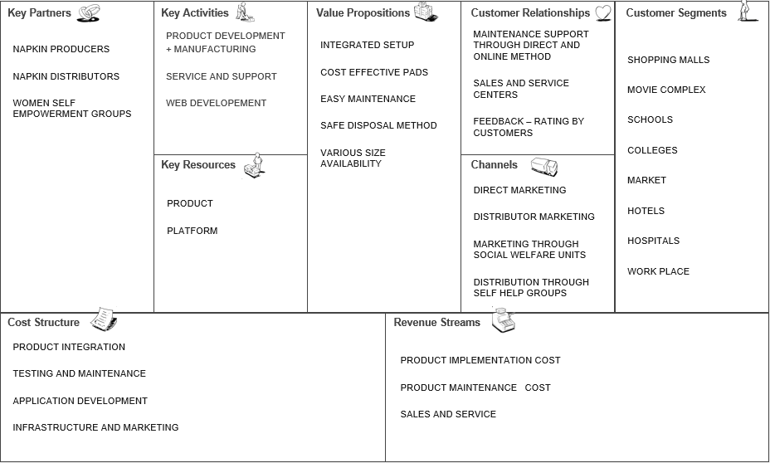
Business Model
Designed for :
Sanitary Napkin vending machine
Version :
6

Slide 14







Uniqueness
Integrated Vending & Dispenser setup
Alerts to Refill
Safe Disposal Method
Helps manufacturers via Analysis of sales Reports
Objective: To Promote the usage of bio-degradable sanitary napkins among rural people also…

Slide 15
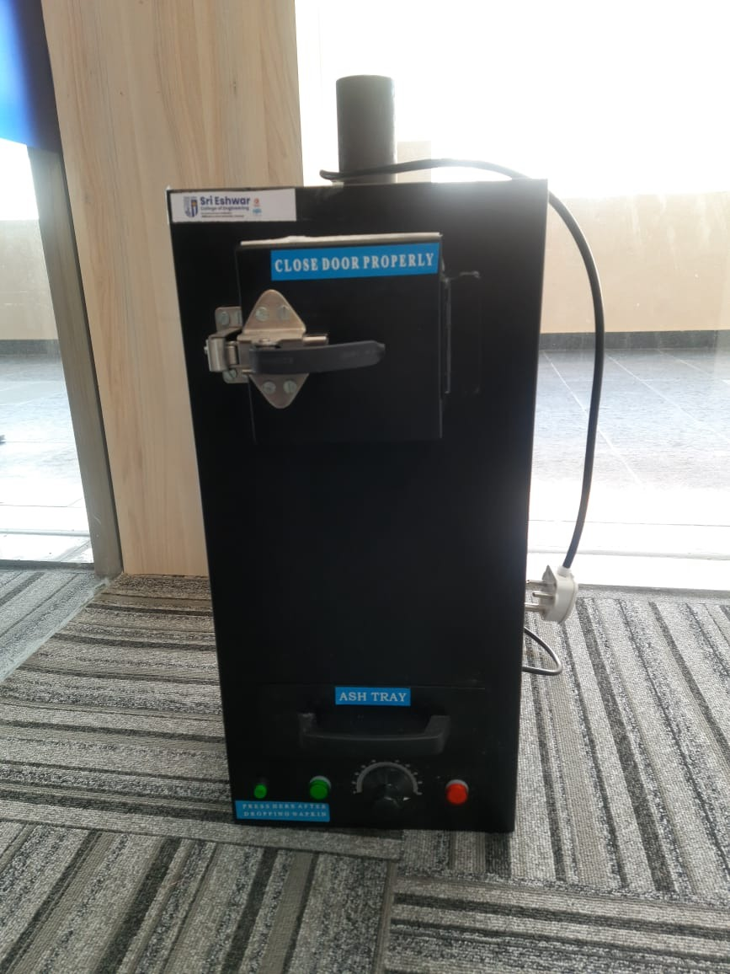
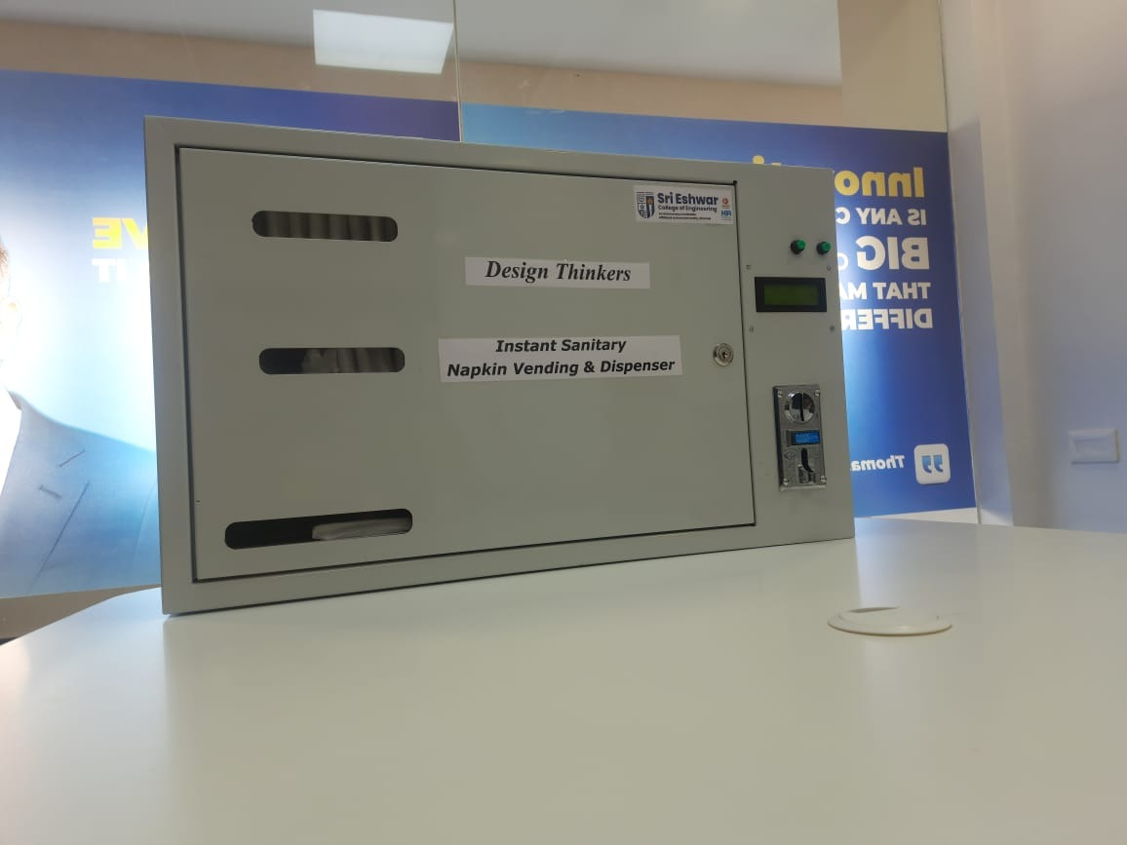
MVP
VENDING MACHINE
DISPENSOR

Slide 16
FOR FURTHER DETAILS AND ENQUIRY
CONTACT NUMBER: 9500230050
MAIL ID: sowndar.kece@sece.ac.in

